Slide 1
Kiva Loans
Exploratory analysis

Slide 2
Table of Contents
Introduction
Tools & Data
Analysis & Results
Conclusion & inferences

Slide 3
Introduction - Project Description & Team Members
Kiva Microfunds is a non-profit organization that allows people to lend money via the Internet to low-income entrepreneurs around the world. Kiva lenders have provided more than a million loans, over $1 billion dollars in loans to over 2 million people. The repayment is between 98 and 99 percent with over a million lenders worldwide. Kiva's mission is “to connect people through lending to alleviate poverty”.
For the locations in which Kiva has active loans, we’ll compare Kiva's data with additional data sources to estimate the welfare level of borrowers in locations, based on economic and demographic characteristics. Additionally, we’ll explore patterns to determine if there are any factors that are significant to each other regarding non-profit loans.
Team Members
David Debreceni Sr.
Gang Ping Zhu
Rovina Rodrigues

Slide 4
Tools & Data
Python Packages
scikit-learn
NumPy
SciPy
Pandas
IPython
matplotlib
Seaborn
plotly
squarify
Data
https://www.kiva.org/about
http://build.kiva.org/
https://www.census.gov/popclock/
http://databank.worldbank.org/data/home.aspx
https://stat.duke.edu/resources/datasets/kiva-loans

Slide 5


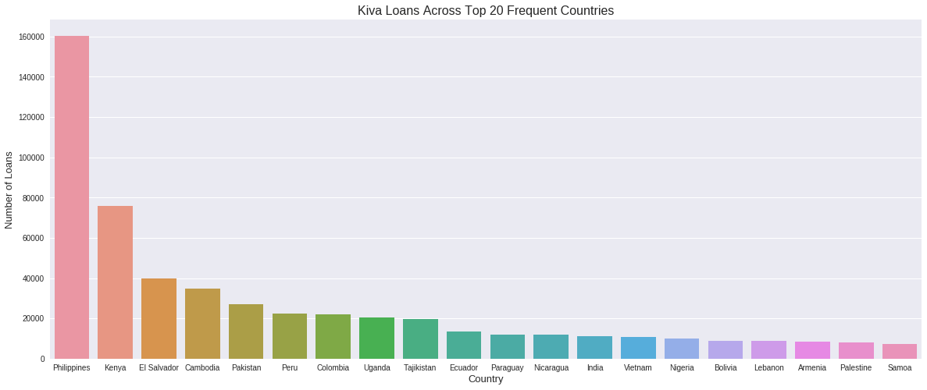


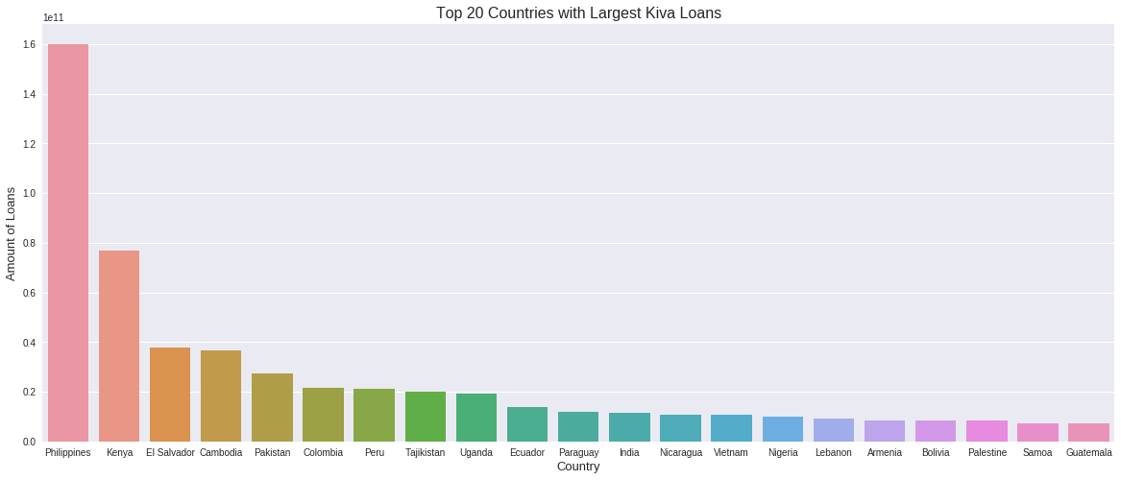

Global Analysis The top three countries that request loans and consequently have the largest loan amounts is Philippines, Kenya, and El Salvador.

Slide 6
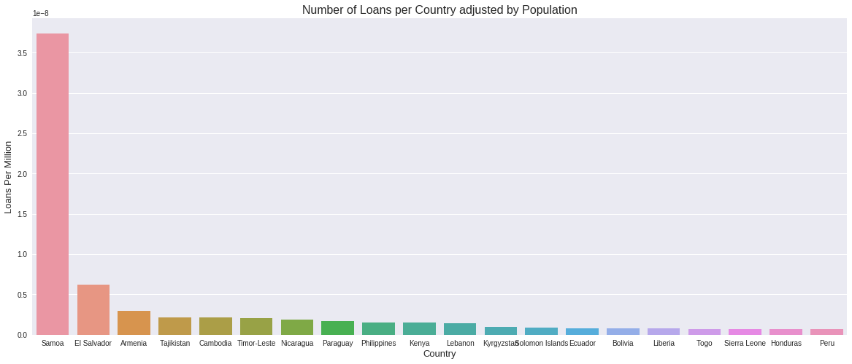
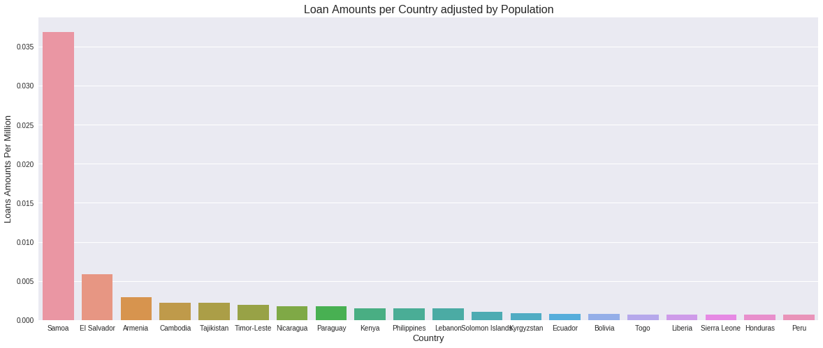
Population Adjustment Adjusting for the population size of 2018, we see that Samoa is the country with most loans given their population. Samoa is followed by El Salvador and Armenia.

Slide 7
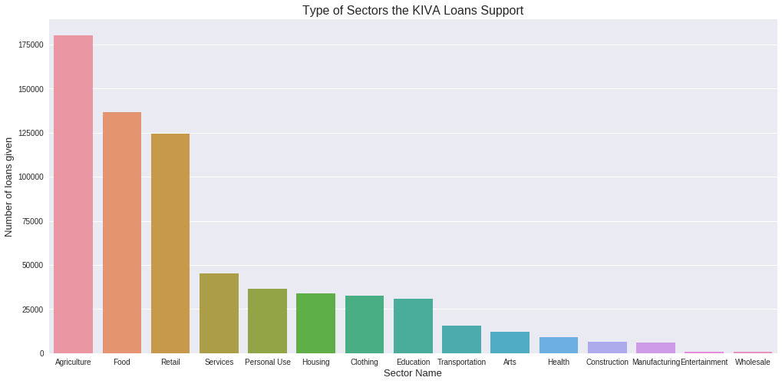
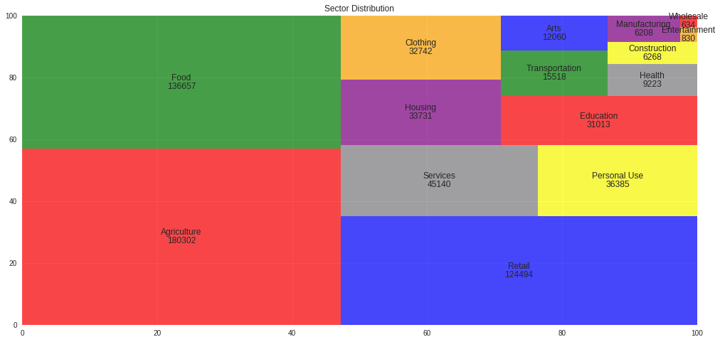
Sector Analysis From our global analysis, we see that agriculture, food, and retail rank amongst the highest in terms of the sectors supported through these non-profit loans. We’ll compare the global analysis to those of the top three countries that have Kiva Loans to see if that trend is consistent across the top three countries.

Slide 8
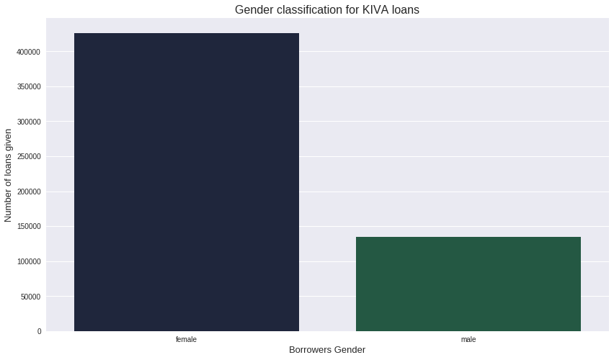

Gender Analysis From our global analysis, we see that females outnumber males when requesting these non-profit loans. We’ll look at other countries to determine if trend is consistent.

Slide 9
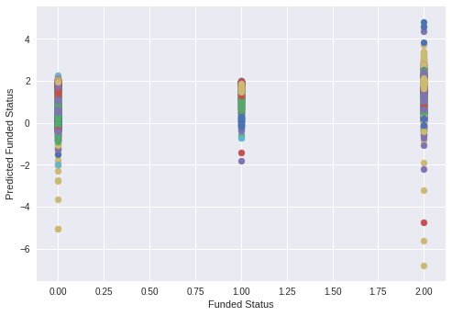
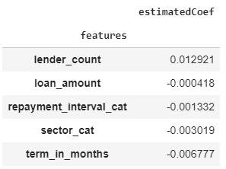
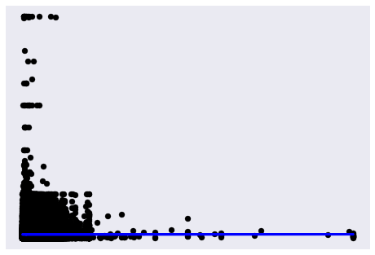
Linear Regression We performed a linear regression on the funded amount and the loan amount to determine if there was anything that we could conclude. After our analysis, we determined that the funded amount rarely differs from the loan amount on Kiva. This could be due to the nature of these requested loans and that it’s crowd sourced. The Funded Statuses in the graph are as follows: Expired = 0 Fundraising = 1 Funded = 2

Slide 10
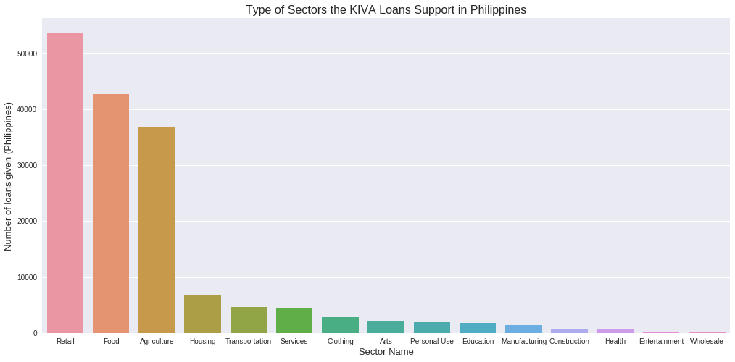
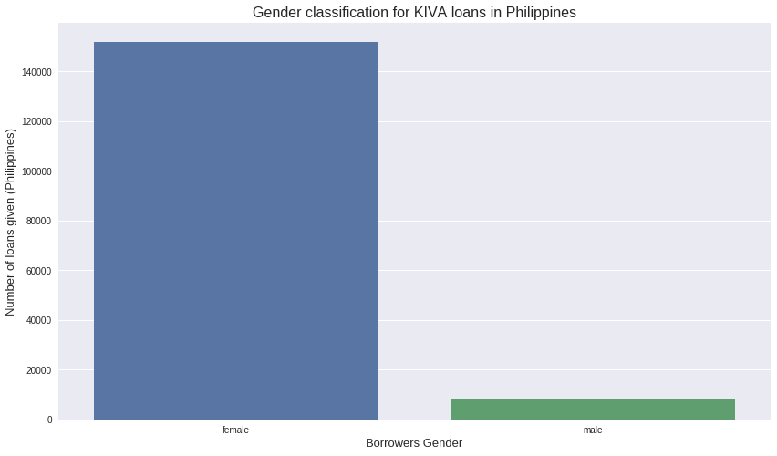
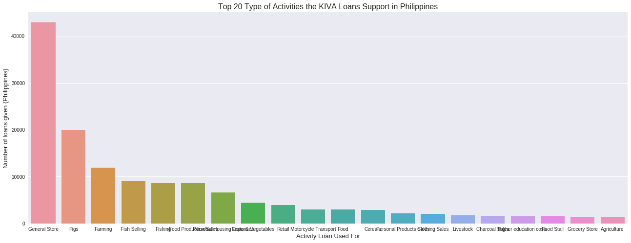
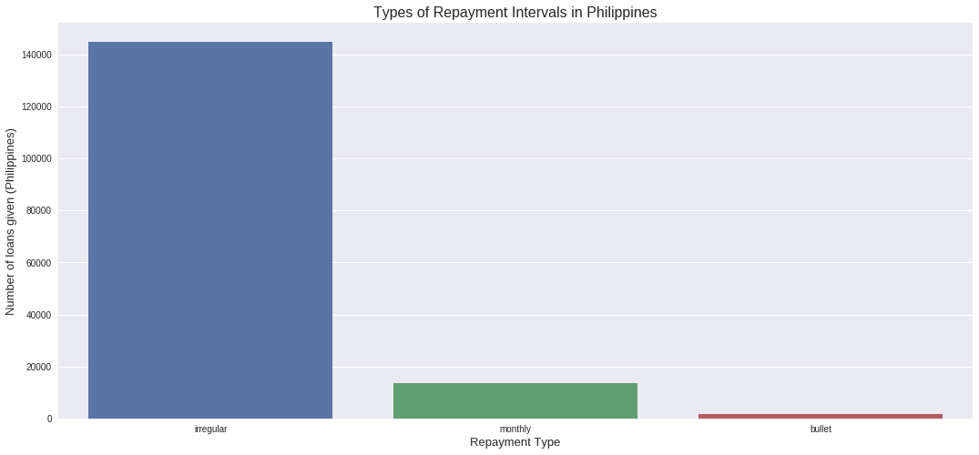
Philippines Analysis

Slide 11
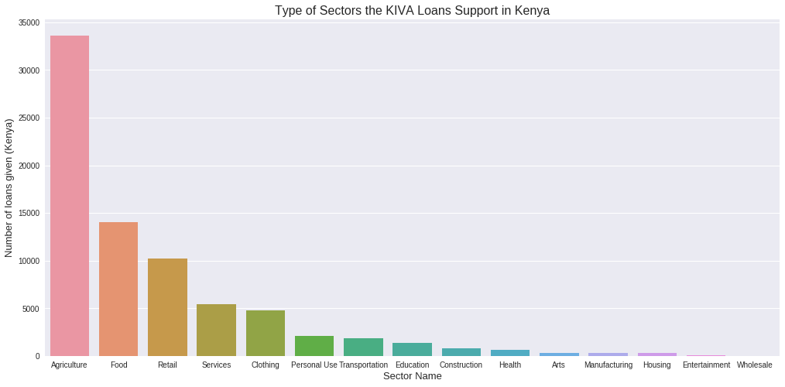
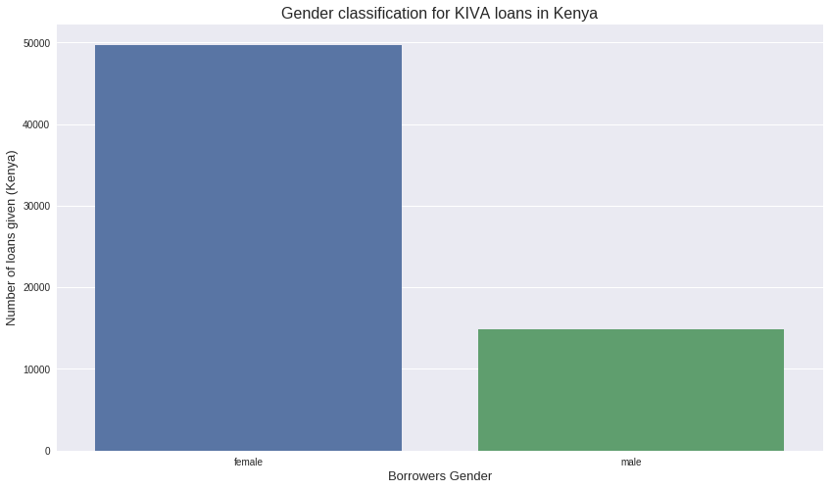
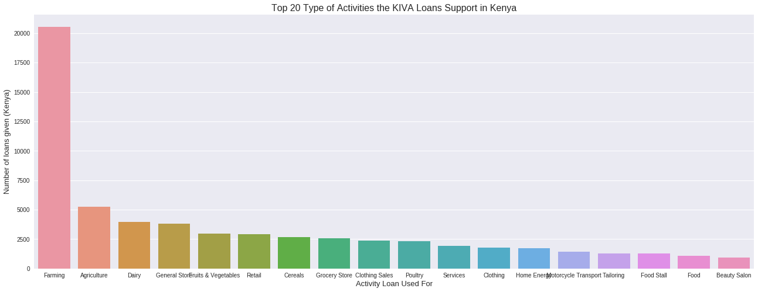
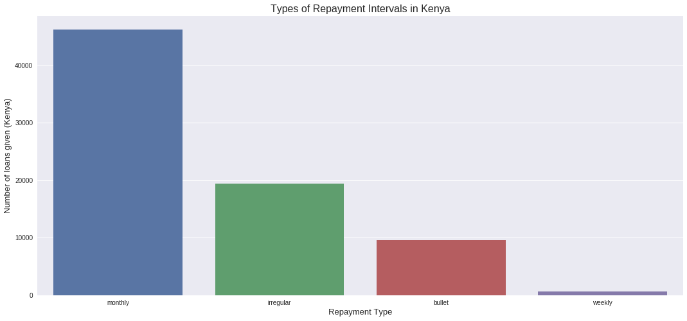
Kenya Analysis

Slide 12
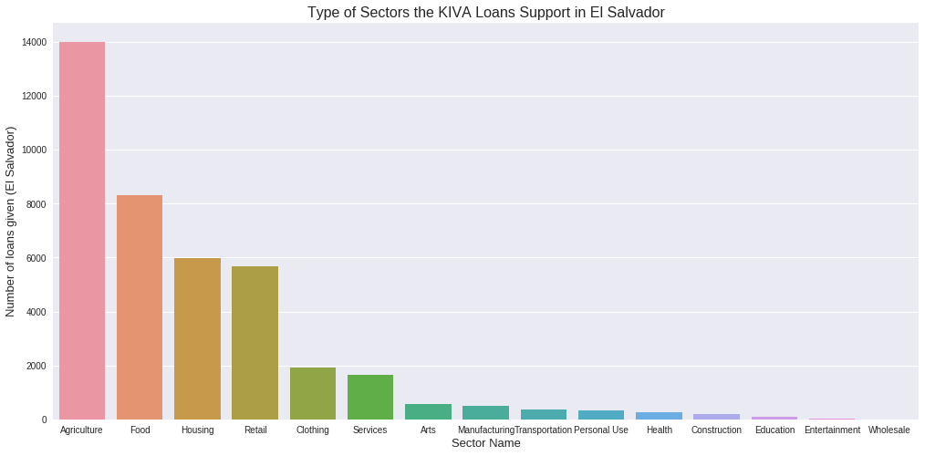
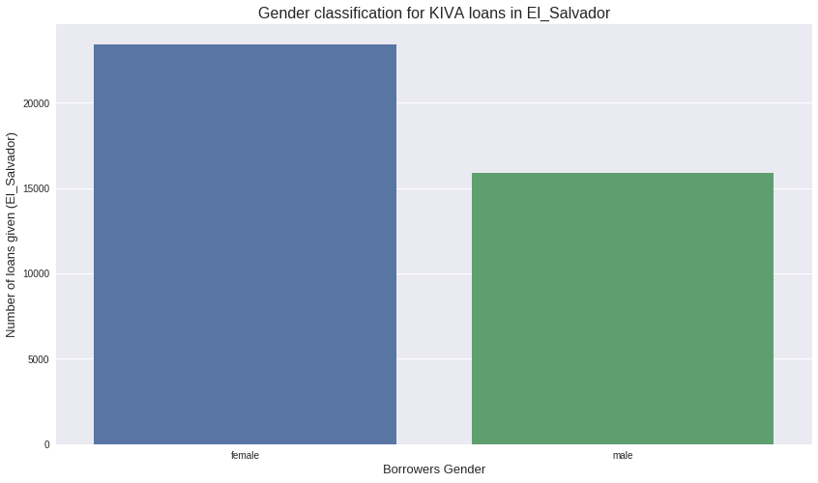
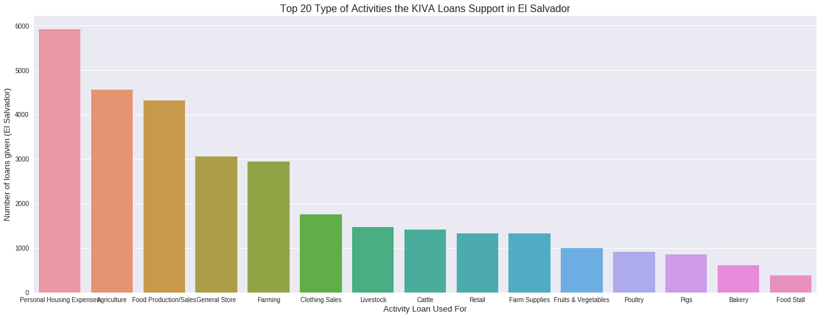
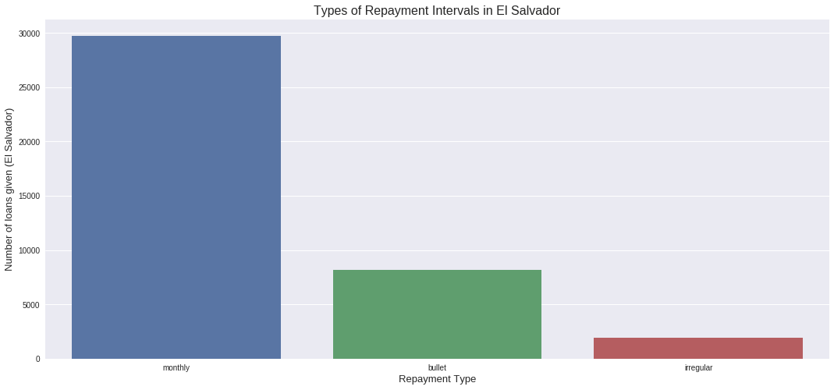
El Salvador Analysis

Slide 13
Conclusion & Inferences
From our comparison of the top three countries of Kiva Loans (Philippines, Kenya, El Salvador), we have discovered the following:
Agriculture and Food loans rank amongst the highest of Sectors across the three countries
The Philippines and Kenya have the Retail sector ranked high
El Salvador has Housing as a high sector
The Philippines and Kenya have a higher majority of females that are involved with Kiva loans
El Salvador has a more equal distribution between males and females but it still leans towards the female population
The Philippines has irregular repayment intervals where as Kenya and El Salvador have monthly repayment internals.

